Slide 1
Community Coalition Summer Initiatives
2023 Report

Slide 2
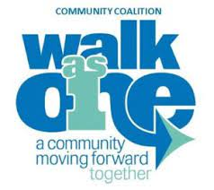

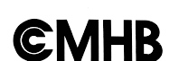
Summer Initiatives
A Collaborative effort between Don Moyer Boys & Girls Club, the Champaign County Community Coalition, and youth-serving grassroots organizations, funded by the Champaign County Mental Health Board
+
+
$90,000 award to Don Moyer Boys & Girls Club, who subcontracts with local grassroots organizations that support the critical mission of providing services to youth and adults in our community
Each subcontractor submits a proposal on their programs and activities for funding
Proposals are approved and awarded by recommendation of the Executive Committee of the Champaign County Community Coalition

Slide 3
DMBGC Subcontracting Process
Convene initial subcontracting meeting to notify awardees and explain initial requirements for funding
Issue contracts
Monitor budgets, spending, and compliance with contracts
Provide support as needed and collect programmatic data

Slide 4




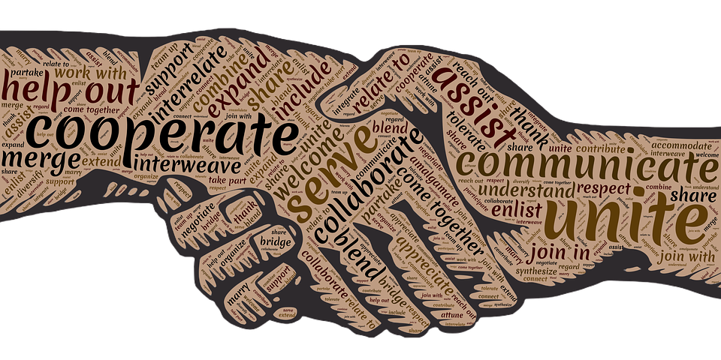
Areas of Focus
Arts & Culture
Recreation
Academic Enrichment
Leadership and Community Engagement
Outcomes
Increase sense of connectedness and engagement with community
Decrease number of violent incidents experienced by participants
Provide opportunities for increased academic success and career awareness
Skill development
Image: Creative Commons

Slide 5
Data Collection Overview + Outcomes

Slide 6
Data Collection Process
All subawardees were instructed to complete a pre- and post-test to analyze the overall outcomes of the programming provided. Pre- and post-tests considered the overall goals of the programming, and were designed to measure self-reported community engagement and connection, to determine if program participation reduced the number of violent incidents experienced by participants, and to measure new skills developed and experiences gained by program participants.

Slide 7
Performance Outcomes
Self-Reported Engagement and Exposure to Violence
Overall increase in respondents reporting they feel “Very Connected” to their community over pre (76%) and post (95%) tests.
Respondents reported a decrease in the number of violent incidents experienced over the program period (50% reduction)
Measurable Skills Gains
Two program participants were placed into employment as a result of program participation and hard skills gained
Participants in professional networking reported increases confidence and mental health self-care skills
Youth participating in a recreational sports academy reported increased confidence, athletic ability, and teamwork skills

Slide 8
Program Data
150 youth were served by the Orange and Blue Kids Camp and Packed for Success backpack drive, supporting recreational and academic engagement and enrichment outcomes
189 total participants (116 youth, 73 adults) received a free meal, community resource connection, and community engagement at Rock the Block events
  Event attendees were largely those impacted by gun violence, and events were conducted in areas reporting high levels of gun violence
5 youth participated in structured internships and developed business and leadership skills
Two networking events provided 50+ participants (aged 30-55+) with mental health self-care workshops, exposure to African American professionals, and business seminars with industry professionals
36+ young men participated in a four-day residential trades camp
  Two participants were placed into employment as a result of the construction skills gained through programming
200+ youth received mentoring services and programming
24 youth participating in the DMBGC Dixon Stars basketball program traveled to 10 tournaments (in four states and nine cities), taking first place four times! The Team also participated in life skills, college visits, and improving leadership and teamwork skills

Slide 9
Testimonials
“I have lived in Champaign over 30 years and I have watched this community change so much. I think this event is a great thing for our community and it shows just how special we are and how strong we can be when we come together the way we did here today. I don’t allow my grandchildren to come outside and play a lot because we don’t live in the best neighborhood, but today we felt safe and we all had a great time.”
“If we had stuff like this on the regular, folks wouldn’t be getting shot left and right around here.”
"I gained a lot of valuable experience and knowledge through volunteering and other work sessions. I was able to practice leadership and get work done for the program & community."
"I learned that there's always a way to make things work.”
"I learned financial literacy, organizational skills…and leadership."

Slide 10
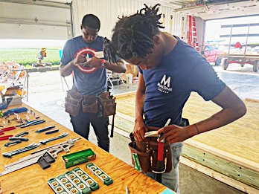
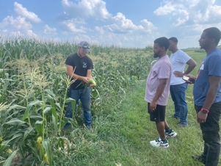
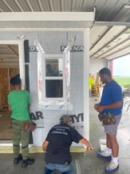
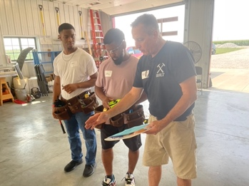
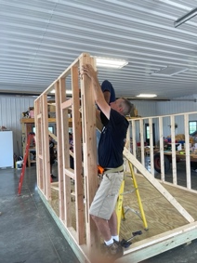
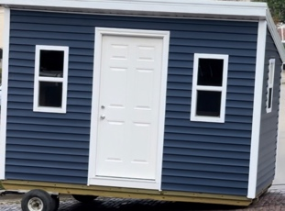
East Central Illinois Youth for Christ

Slide 11

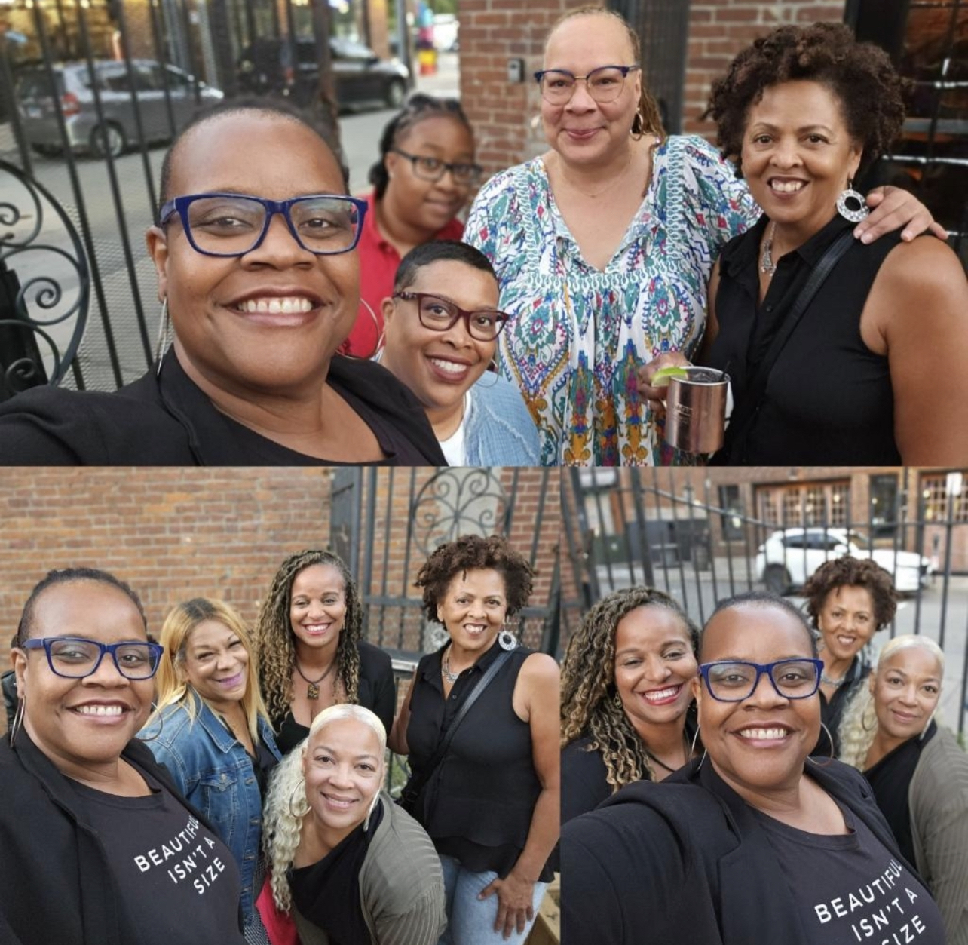
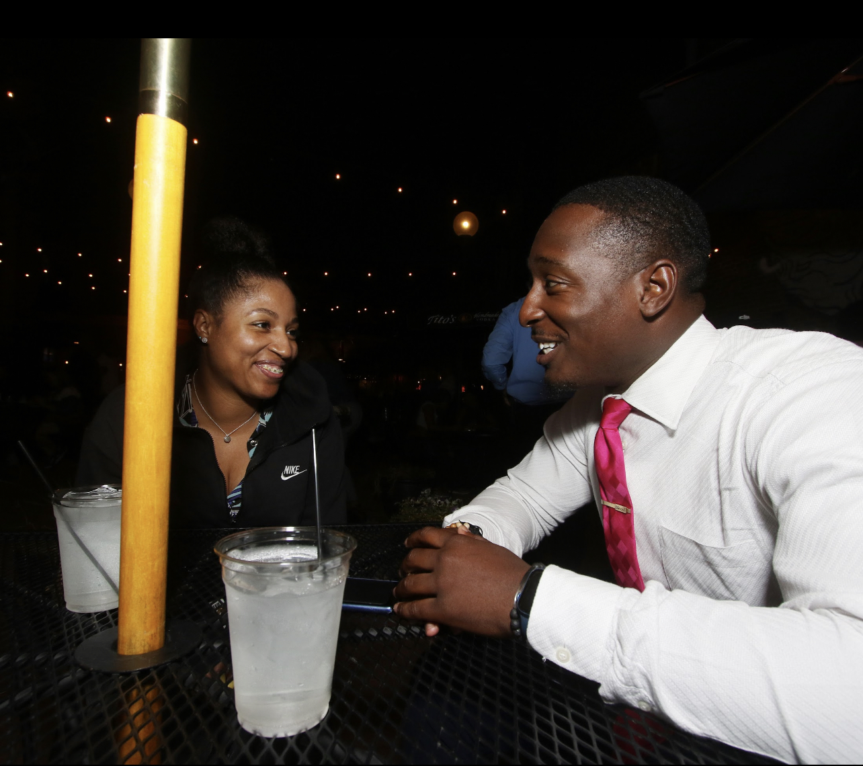
Media Doll Marketing

Slide 12
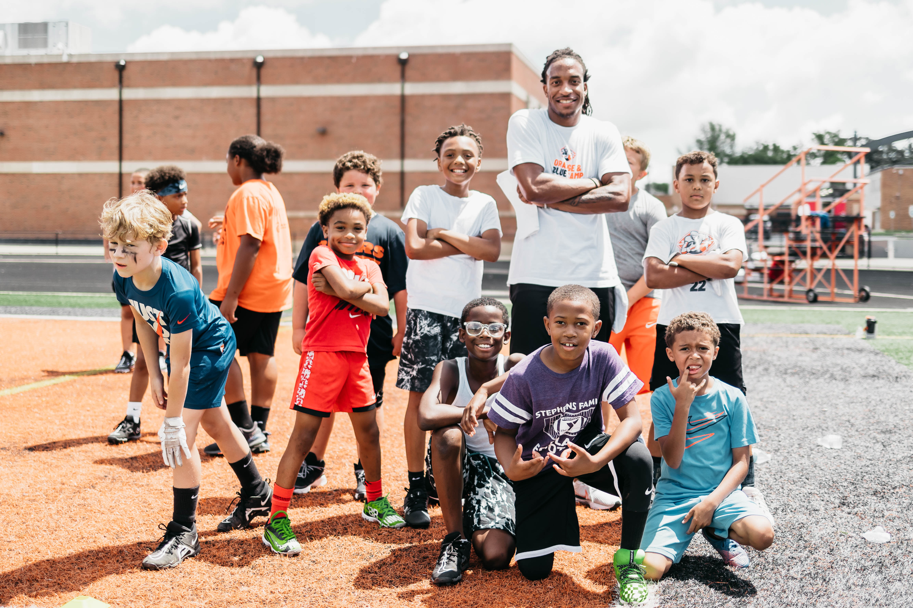
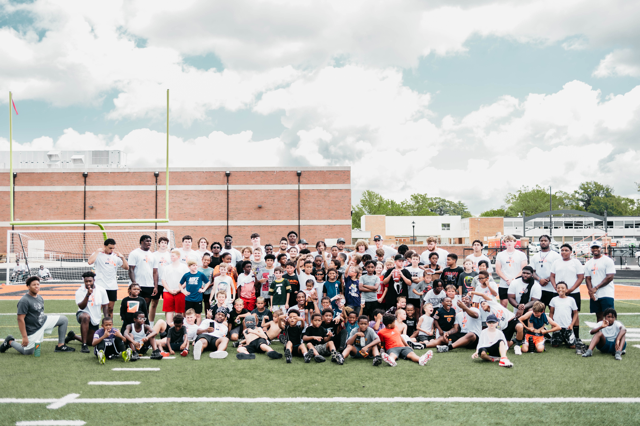
Leitsey Family Foundation

Slide 13
Rock the Block – Slim Entertainment

Slide 14
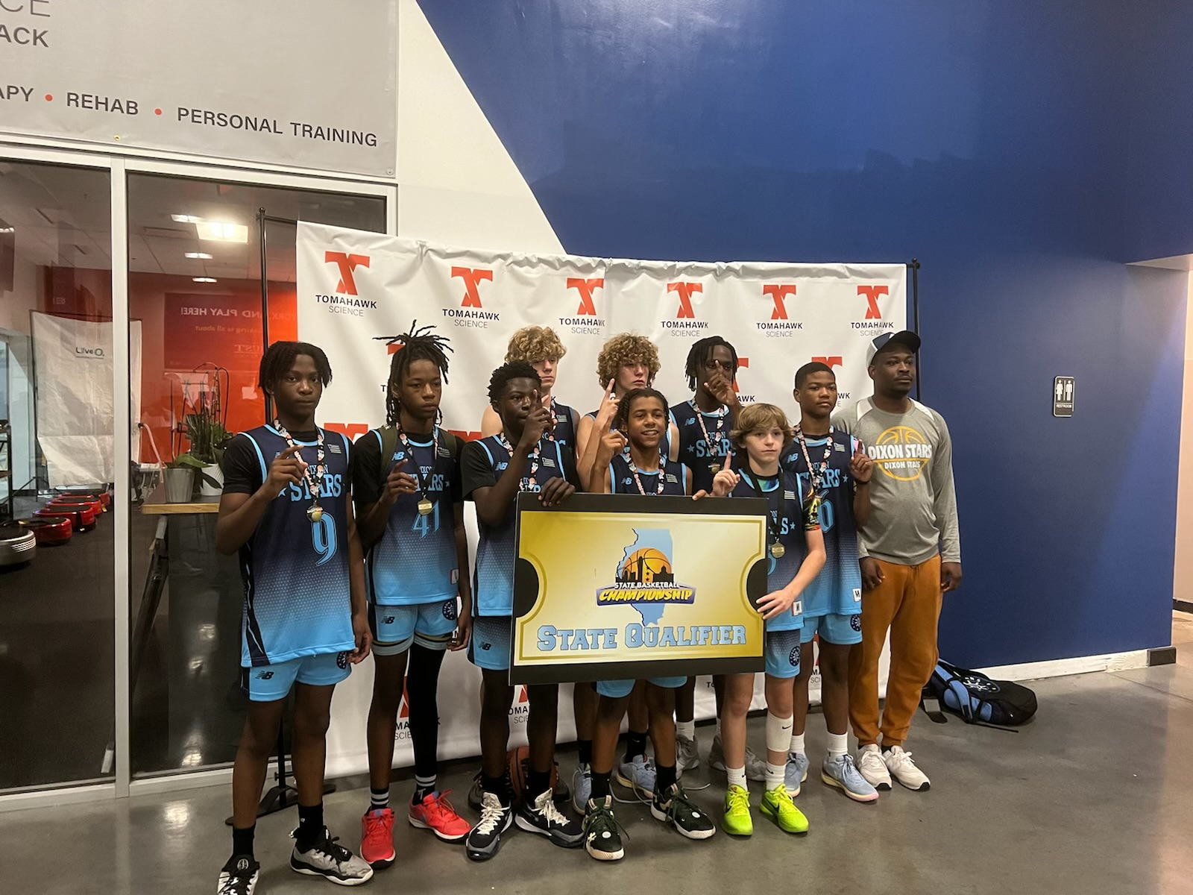
DMBGC Dixon All Stars
The DMBGC Dixon All Stars 8th Grade Boys basketball team took first in the middle school state tournament (with the league taking four first place spots throughout the program). Youth participated in leadership and service opportunities in addition to learning about recreational and competitive sports skills.

